Slide 1

New Jersey Department of Labor and Workforce Development
Division of Economic & Demographic
Research
Labor Market Information Update for May 2026
Prepared: July 2026

Slide 2
Monthly Total Nonfarm Employment
4,391,300
4,386,000
4,388,200
4,384,000
4,379,100
4,380,500
4,378,900
4,377,200
4,375,100
4,375,800
4,373,800
4,373,400
4,369,500
May-25
Jun-25
Jul-25
Aug-25
Sep-25
Oct-25
Nov-25
Dec-25
Jan-26
Feb-26
Mar-26
Apr-26
May-26

Slide 3
Monthly Private Sector Employment Change
+10,200
+5,400
+6,000
+3,400
+3,100
+2,300
+900
+900
-900
-200
-2,200
-7,700
-11,300
May-25
Jun-25
Jul-25
Aug-25
Sep-25
Oct-25
Nov-25
Dec-25
Jan-26
Feb-26
Mar-26
Apr-26
May-26

Slide 4
Month-Over-Month Employment Change: Apr 2026 - May 2026
Total Nonfarm Change: +2,200 (+0.1%)
Leisure and Hospitality
+0.7%
Government
+0.2%
Construction
+0.4%
Trade, Transportation,
and Utilities
+0.0%
0.0% Information
-0.1%
Financial Activities
-0.2%
Other Services
-0.0%
Private Education and Health Services
-0.2%
Manufacturing
-0.2%
Professional and Business Services
-2,000
-1,000
0
1,000
2,000
3,000

Slide 5
Year-Over-Year Employment Change: May 2025 - May 2026
Total Nonfarm Change: -3,100 (-0.1%)
Private Education and
+3.3%
Health Services
-0.1%
Professional and Business Services
-1.5%
Information
-0.9%
Other Services
-1.0%
Financial Activities
-0.4%
Government
-2.3%
Construction
-2.0%
Manufacturing
-1.3%
Leisure and Hospitality
-0.7%
Trade, Transportation, and Utilities
-10,000
0
10,000
20,000
30,000

Slide 6
Unemployment Rates
United States New Jersey
New Jersey May 2025
5.5%
5.5%
5.5%
New Jersey May 2026
5.4%
5.4%
5.4%
5.2%
5.2%
5.1%
4.9%
4.8%
4.7%
4.4%
4.5%
4.4%
4.4%
4.3%
4.3%
4.3%
4.3%
4.3%
4.3%
4.3%
4.1%
United States May 2025
United States May 2026
No household survey was conducted for October 2025 due to the federal lapse in appropriations.
May-25
Jun-25
Jul-25
Aug-25
Sep-25
Oct-25
Nov-25
Dec-25
Jan-26
Feb-26
Mar-26
Apr-26
May-26

Slide 7
New Jersey Labor Force Participation Rate and Employment to Population Ratio
Labor Force Participation Rate (%)
63.6
63.6
63.6
63.7
63.7
63.7
63.6
63.6
63.5
63.5
63.4
63.5
Employment - Population Ratio (%)
60.4
60.4
60.5
60.2
60.2
60.3
60.3
60.3
60.3
60.1
60.1
60.1
No household survey was conducted for October 2025 due to the federal lapse in appropriations.
May-25
Jun-25
Jul-25
Aug-25
Sep-25
Oct-25
Nov-25
Dec-25
Jan-26
Feb-26
Mar-26
Apr-26
May-26

Slide 8
New Jersey Unemployed Residents
Year-Over-Year: -28,257
267,686
270,340
270,243
264,786
263,630
256,800
262,715
254,637
248,452
240,914
233,963
228,543
May-25
Jun-25
Jul-25
Aug-25
Sep-25
Oct-25
Nov-25
Dec-25
Jan-26
Feb-26
Mar-26
Apr-26
May-26
No household survey was conducted for October 2025 due to the federal lapse in appropriations.

Slide 9
New Jersey Employed Residents
Year-Over-Year: +39,513
4,665,813
4,669,460
4,680,657
4,655,110
4,655,408
4,663,409
4,663,876
4,641,144
4,636,881
4,635,972
4,638,766
4,644,843
May-25
Jun-25
Jul-25
Aug-25
Sep-25
Oct-25
Nov-25
Dec-25
Jan-26
Feb-26
Mar-26
Apr-26
May-26
No household survey was conducted for October 2025 due to the federal lapse in appropriations.

Slide 10
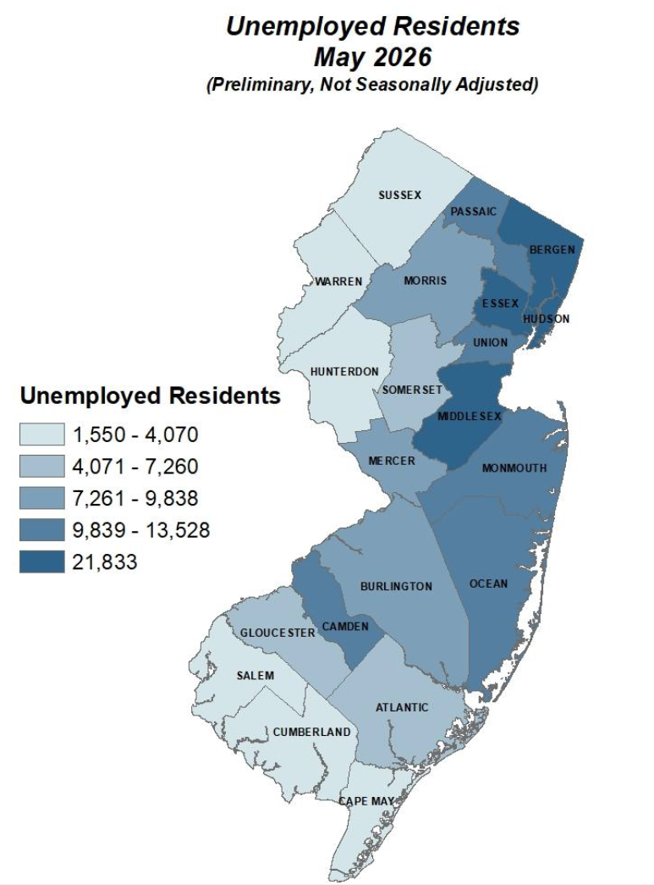
Source: Local Area Unemployment Statistics (LAUS), 2025 Benchmark
Prepared by:
New Jersey Department of Labor and Workforce Development
Bureau of Labor Market Information
May 2026

Slide 11
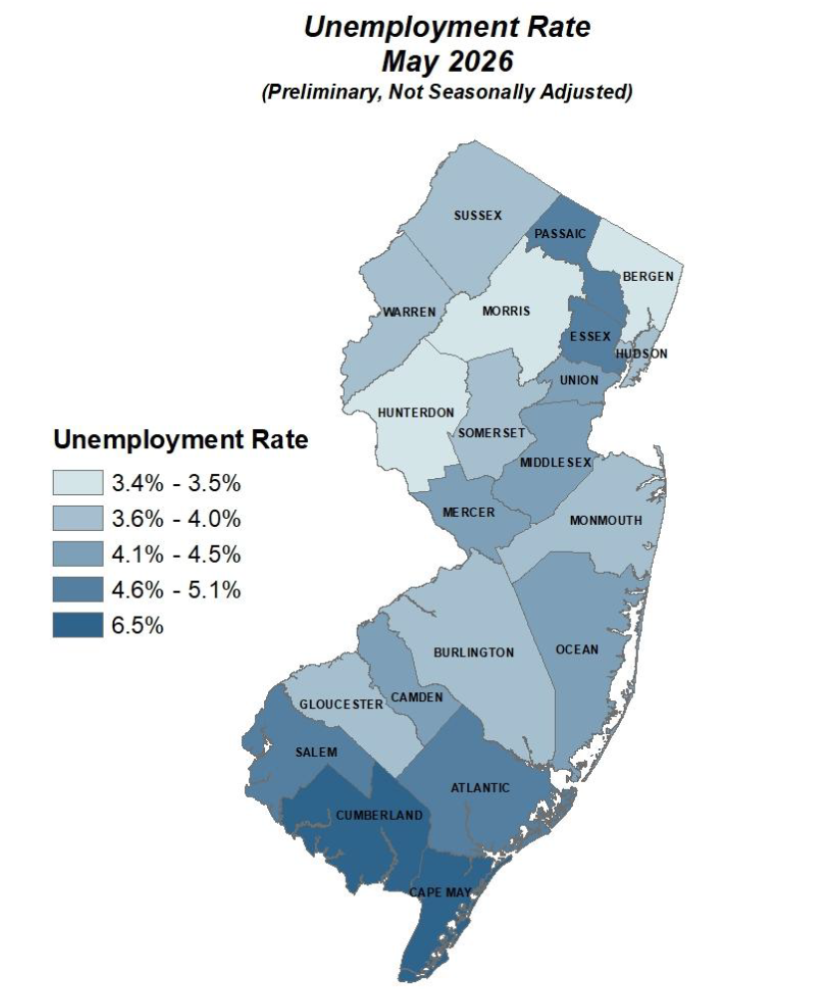
Source: Local Area Unemployment Statistics (LAUS), 2025 Benchmark
Prepared by:
New Jersey Department of Labor and Workforce Development
Bureau of Labor Market Information
May 2026

Slide 12
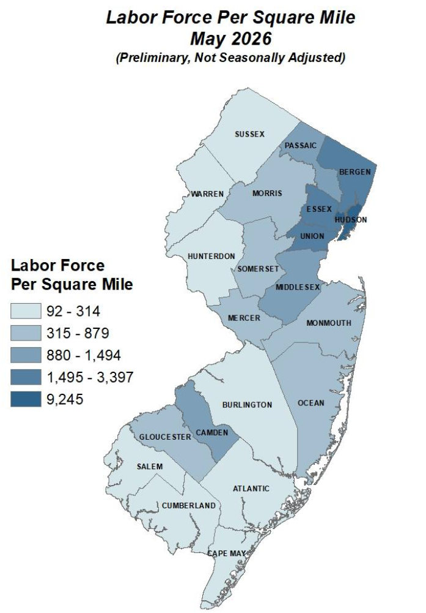
Source: Local Area Unemployment Statistics (LAUS), 2025 Benchmark
Prepared by:
New Jersey Department of Labor and Workforce Development
Bureau of Labor Market Information
May 2026

Slide 13
Monthly Initial Unemployment Claims
Year-Over-Year: -4,730
68,871
57,140
54,082
45,637
44,631
43,102
43,269
38,503
39,040
39,837
39,341
36,417
33,773
May-25
Jun-25
Jul-25
Aug-25
Sep-25
Oct-25
Nov-25
Dec-25
Jan-26
Feb-26
Mar-26
Apr-26
May-26

Slide 14
Real Time Jobs in Demand
Top 10 Occupational Listings
Occupation Demand and Employment
SOC CODE* | OCCUPATION TITLE | # of Job Postings 2026 | # Employed 2024 (BLS/OES)
29-1141 | Registered Nurses................................................................... | 3,740 | 78,340
15-1252 | Software Developers.............................................................. | 3,575 | 54,920
41-2031 | Retail Salespersons................................................................. | 2,651 | 104,660
53-3032 | Heavy and Tractor-Trailer Truck Drivers.................................... | 2,249 | 49,730
41-1011 | First-Line Supervisors of Retail Sales Workers............................ | 1,822 | 27,720
43-4051 | Customer Service Representatives........................................... | 1,560 | 62,490
11-1021 | General and Operations Managers........................................... | 1,499 | 63,940
31-1120 | Home Health Aides................................................................. | 1,475 | 89,210
11-9111 | Medical and Health Services Managers..................................... | 1,386 | 16,490
41-4012 | Sales Representatives, Wholesale and Manufacturing................ | 1,362 | 35,440
*ONET-6

Slide 15
Real Time Jobs in Demand
Top 10 Locations

Slide 16
Real Time Jobs in Demand
Top 10 Industries
Source: Burning Glass Technologies, Labor Insight

Slide 17
NJ Department of Labor & Workforce Development Offers Empowering
Labor Market Information
Population and Demographic Trends
  Census Data
  Population and Household Estimates
Economic Data
  Labor Force Estimates
  Unemployment Rates
  Employment Data
  Industry and Occupational Employment Projections
  Population and Labor Force Projections
  Occupational Wage Rates
  Building Permits

Slide 18

NJLWD Resources
Labor Market Information
https://www.nj.gov/labor/labormarketinformation/

